Slide 1
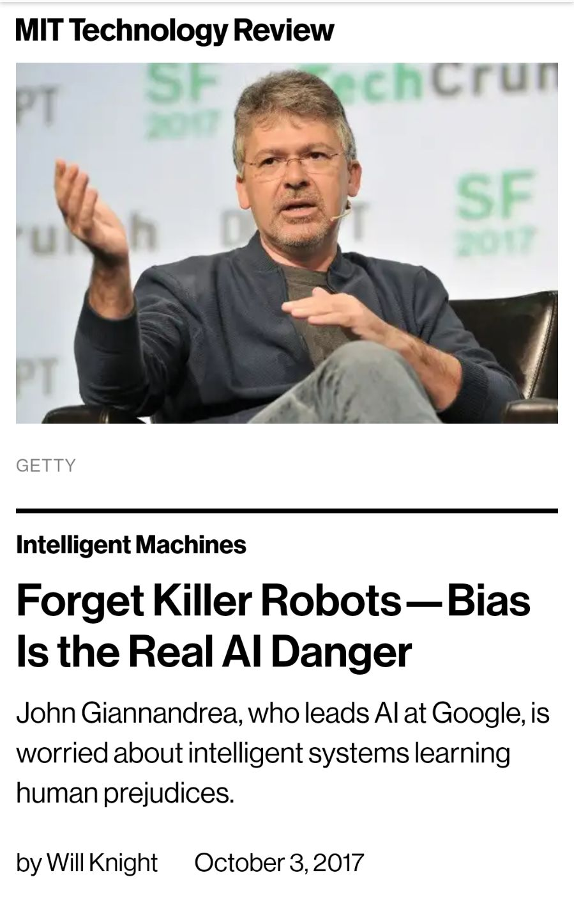
Learning Bias
The inductive bias (also known as learning bias) of a learning algorithm is the set of assumptions that the learner uses to predict outputs given inputs that it has not encountered.^{[1]}
In machine learning, one aims to construct algorithms that are able to learn to predict a certain target output. To achieve this, the learning algorithm is presented some training examples that demonstrate the intended relation of input and output values. Then the learner is supposed to approximate the correct output, even for examples that have not been shown during training. Without any additional assumptions, this problem cannot be solved exactly since unseen situations might have an arbitrary output value. The kind of necessary assumptions about the nature of the target function are subsumed in the phrase inductive bias.^{[1][2]}
(Wikipedia)

Slide 2
What does it mean?
In ML algorithms the assumptions and decisions taken by the machine is affected by the data used to train the data.
This runs the risk of amplifying biases present in data.
Since the program doesn’t ‘need to explain’ the decisions it takes, it might be hard to witness such biases present in the machine’s ‘algorithm’.
Therefore, relying on ML algorithms when taking decisions might be risky.
https://www.youtube.com/watch?v=59bMh59JQDo

Slide 3
Machine Learning 101

Slide 4
What is it good for?
Reduce valuable time while solving a programming problem (e.g write a grammar checker)
Solve problems which are impossible to solve with regular tools (e.g recognize a face)

Slide 5
Applications
Recognize letters/digits from written text
Face recognition (Image recognition)
Spam filtering
Clustering - Dividing a set of inputs into groups
Prediction

Slide 6
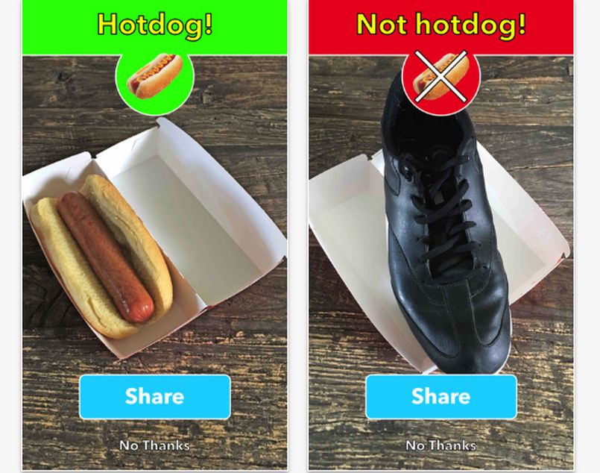
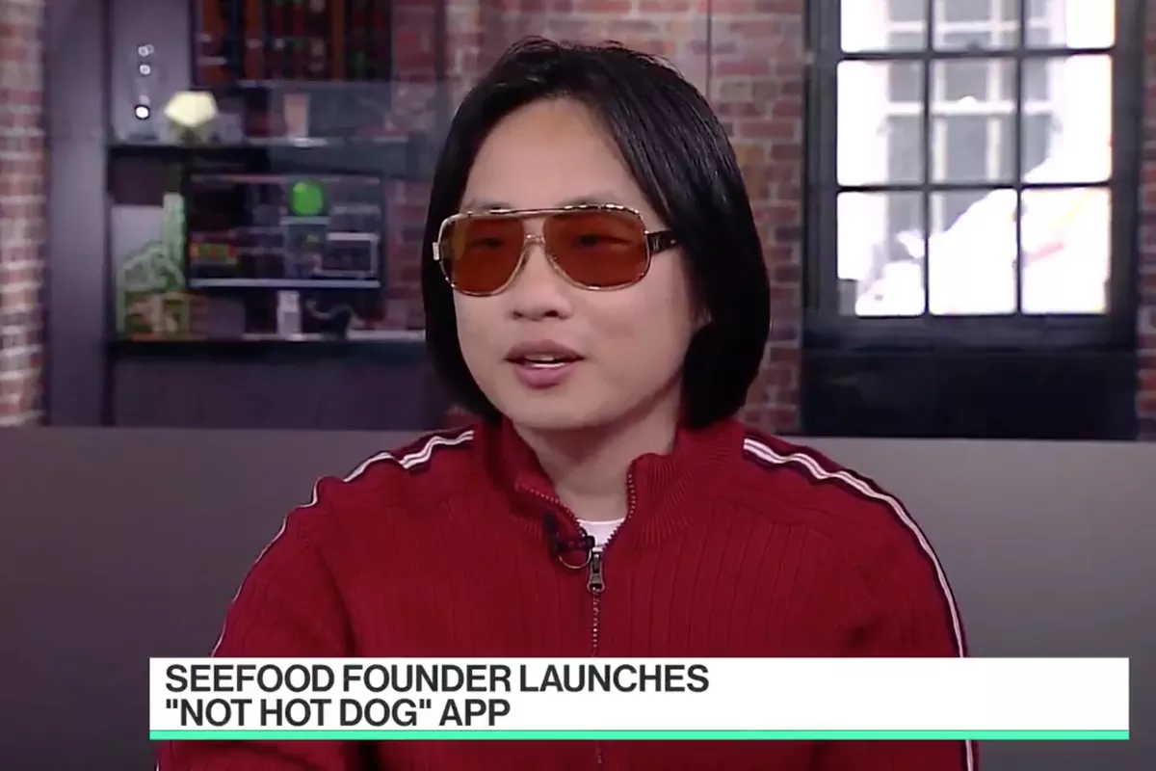
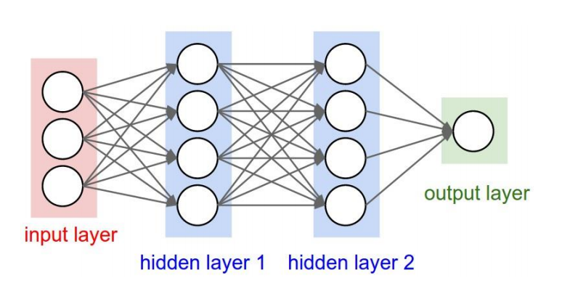
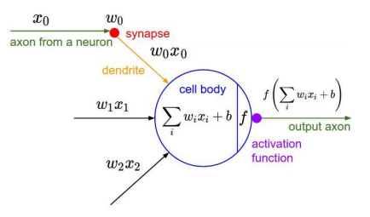
Neural network

Slide 7
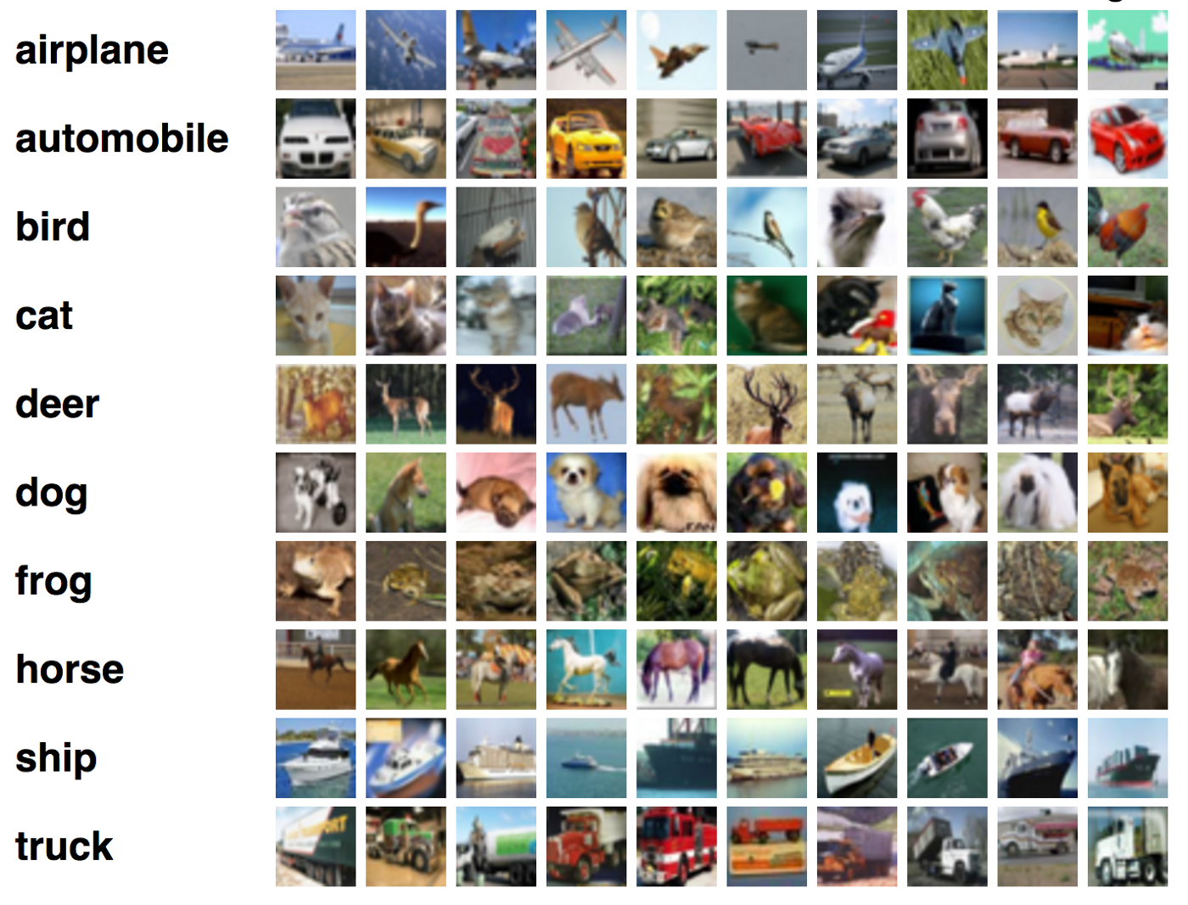
Dataset

Slide 8
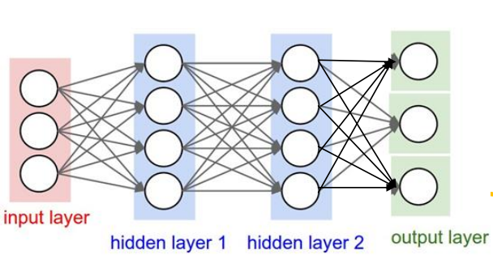

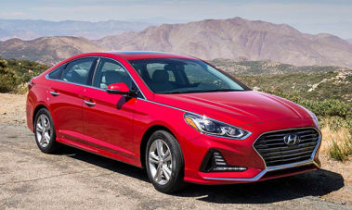
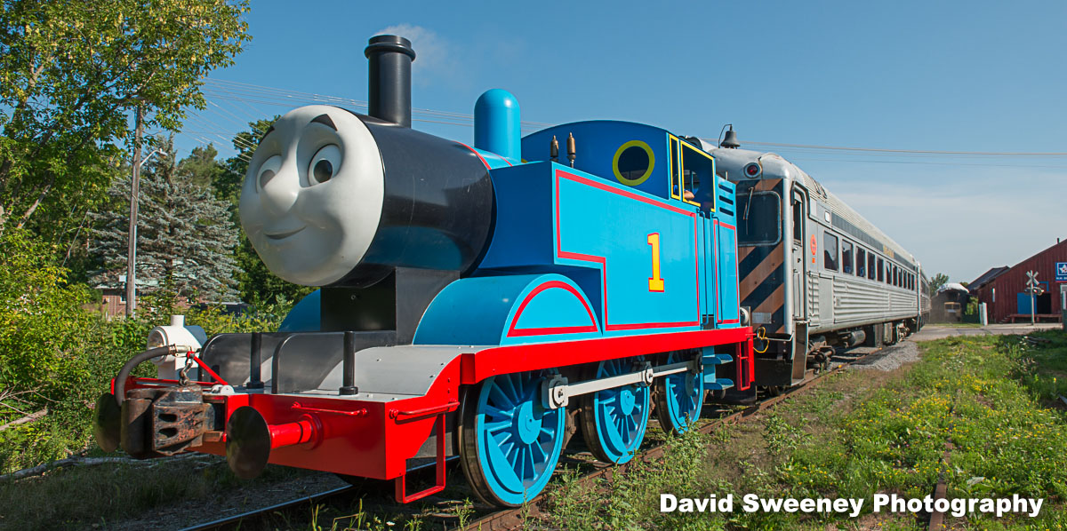
Training a neural network
airplane
1
0
0
0
1
0
0
0
1
train
car

Slide 9
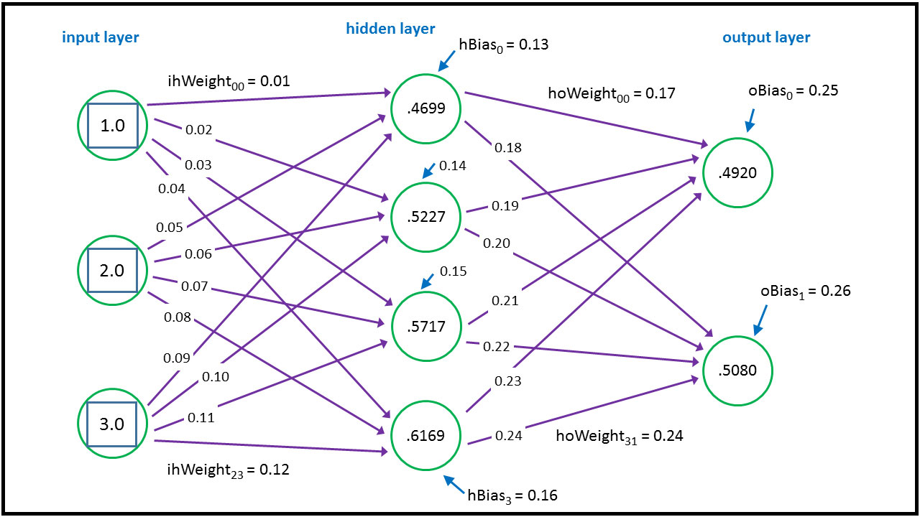
Trained neural network

Slide 10
Bias in dataset causes bias in results
We wanted to build a classifier that distinguishes between cats and dogs.
We trained our classifier using Google’s TensorFlow package for ML.
We created our dataset using Google images by querying: ‘white dog’ and ‘black cat’.

Slide 11
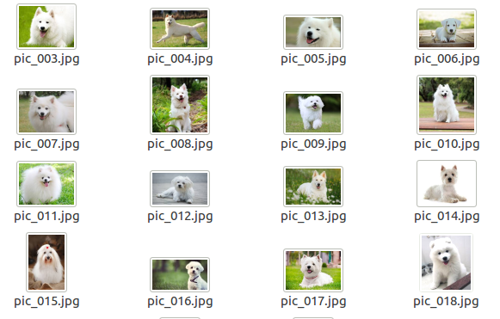
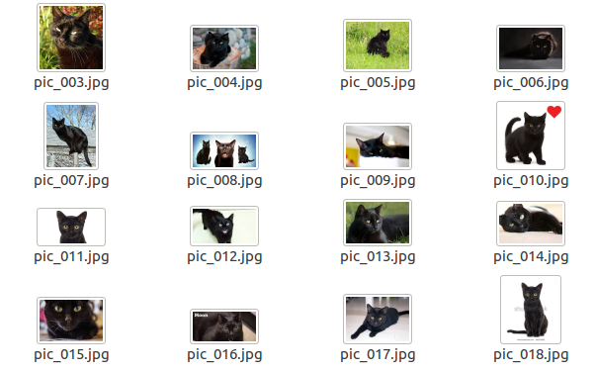
Our dataset

Slide 12
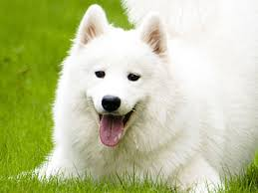
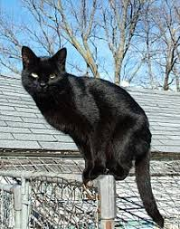
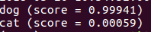
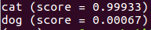
Sanity check

Slide 13
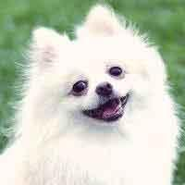
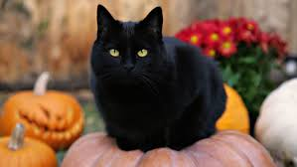
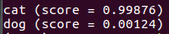
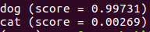
Some results

Slide 14
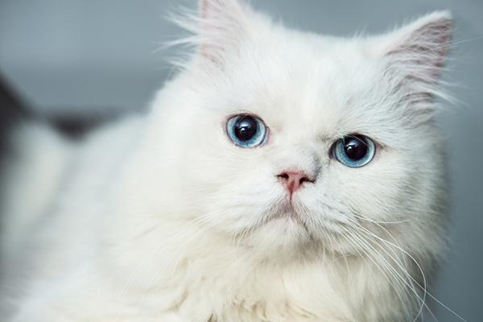
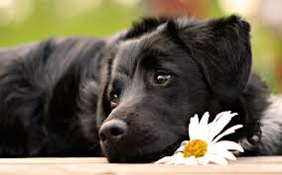
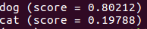
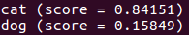
Some results

Slide 15
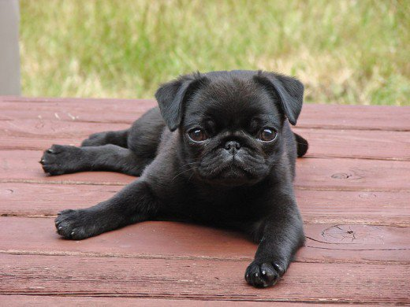
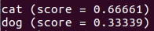
But wait...

